Slide 1
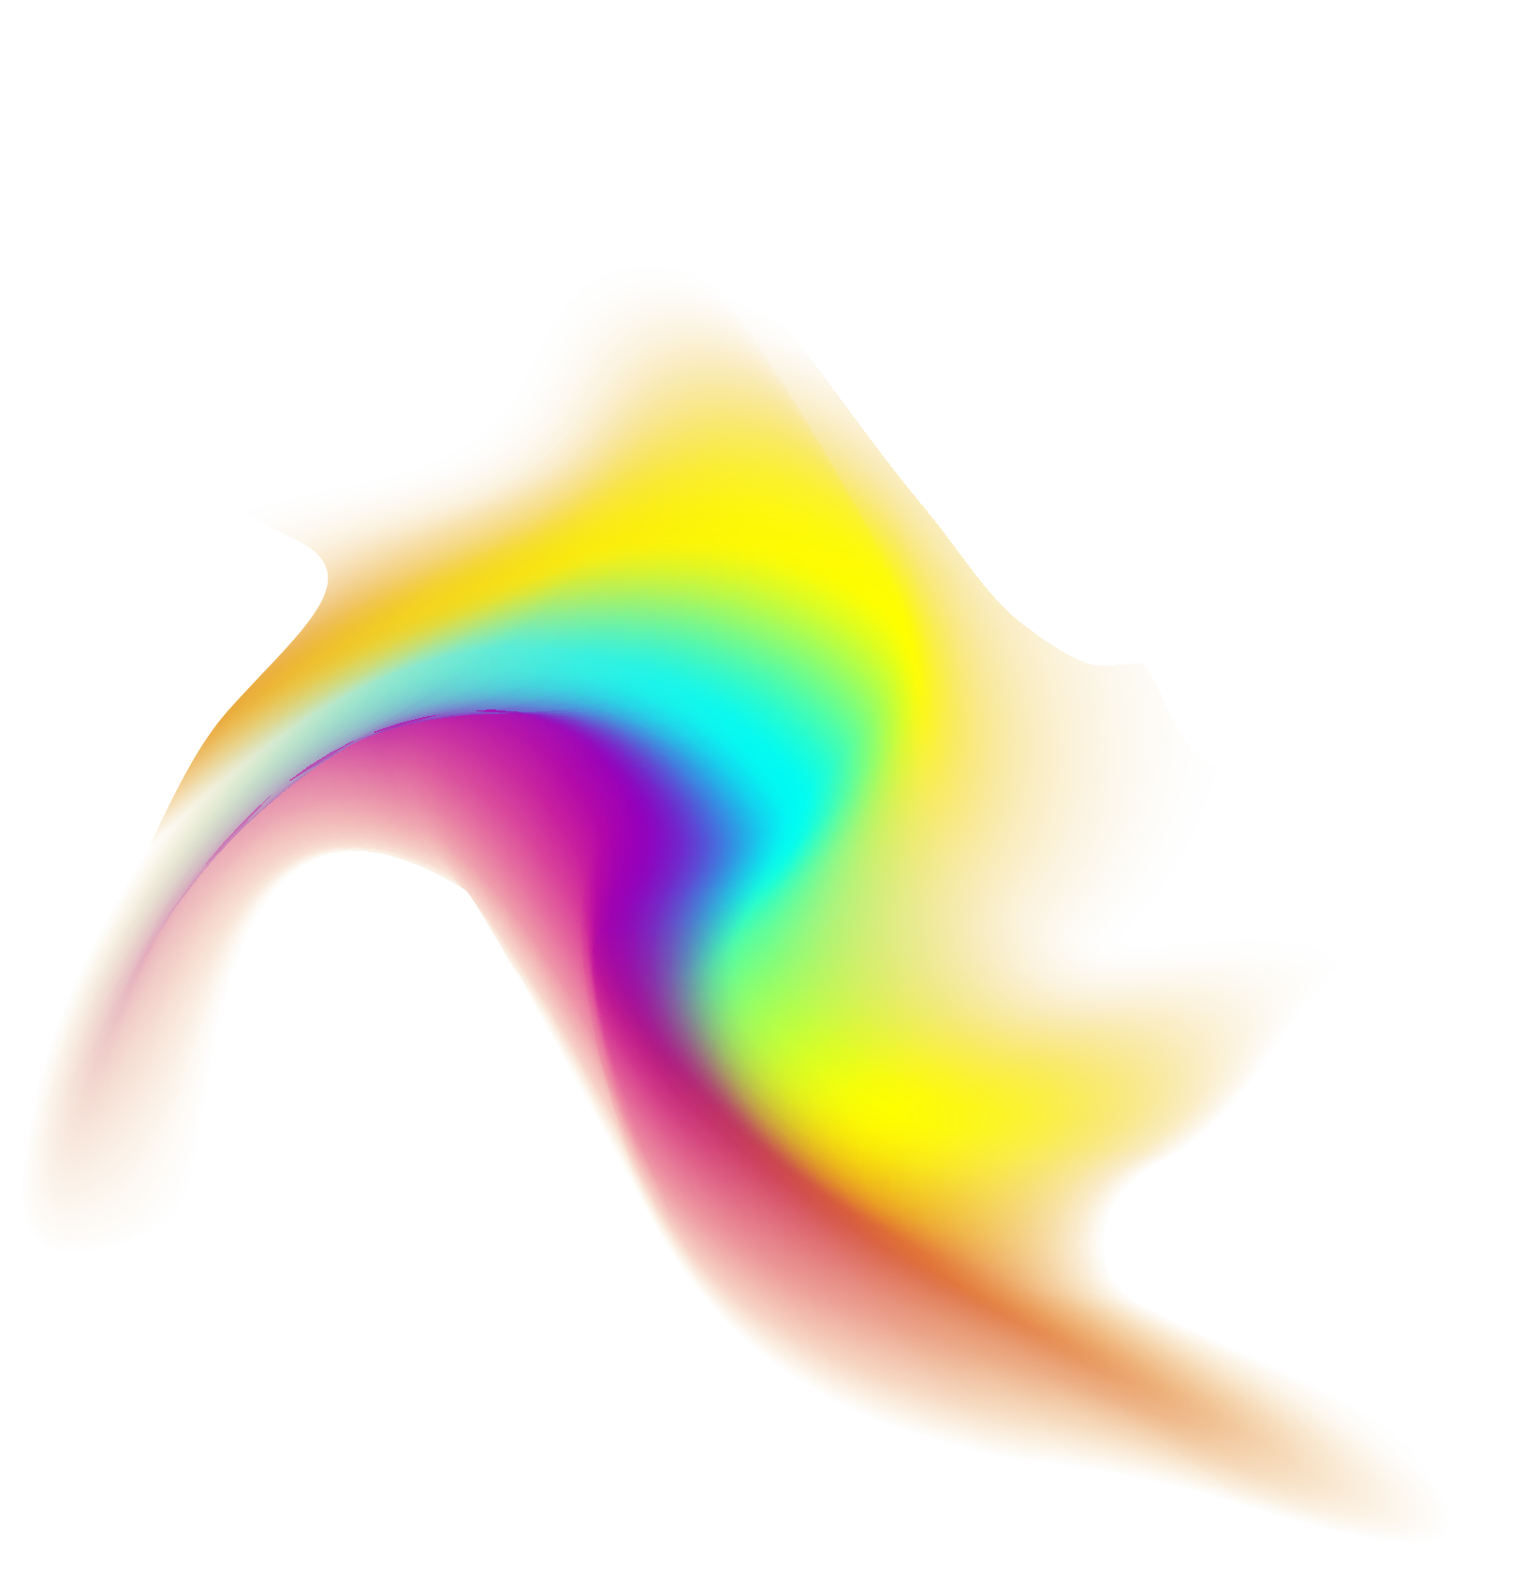
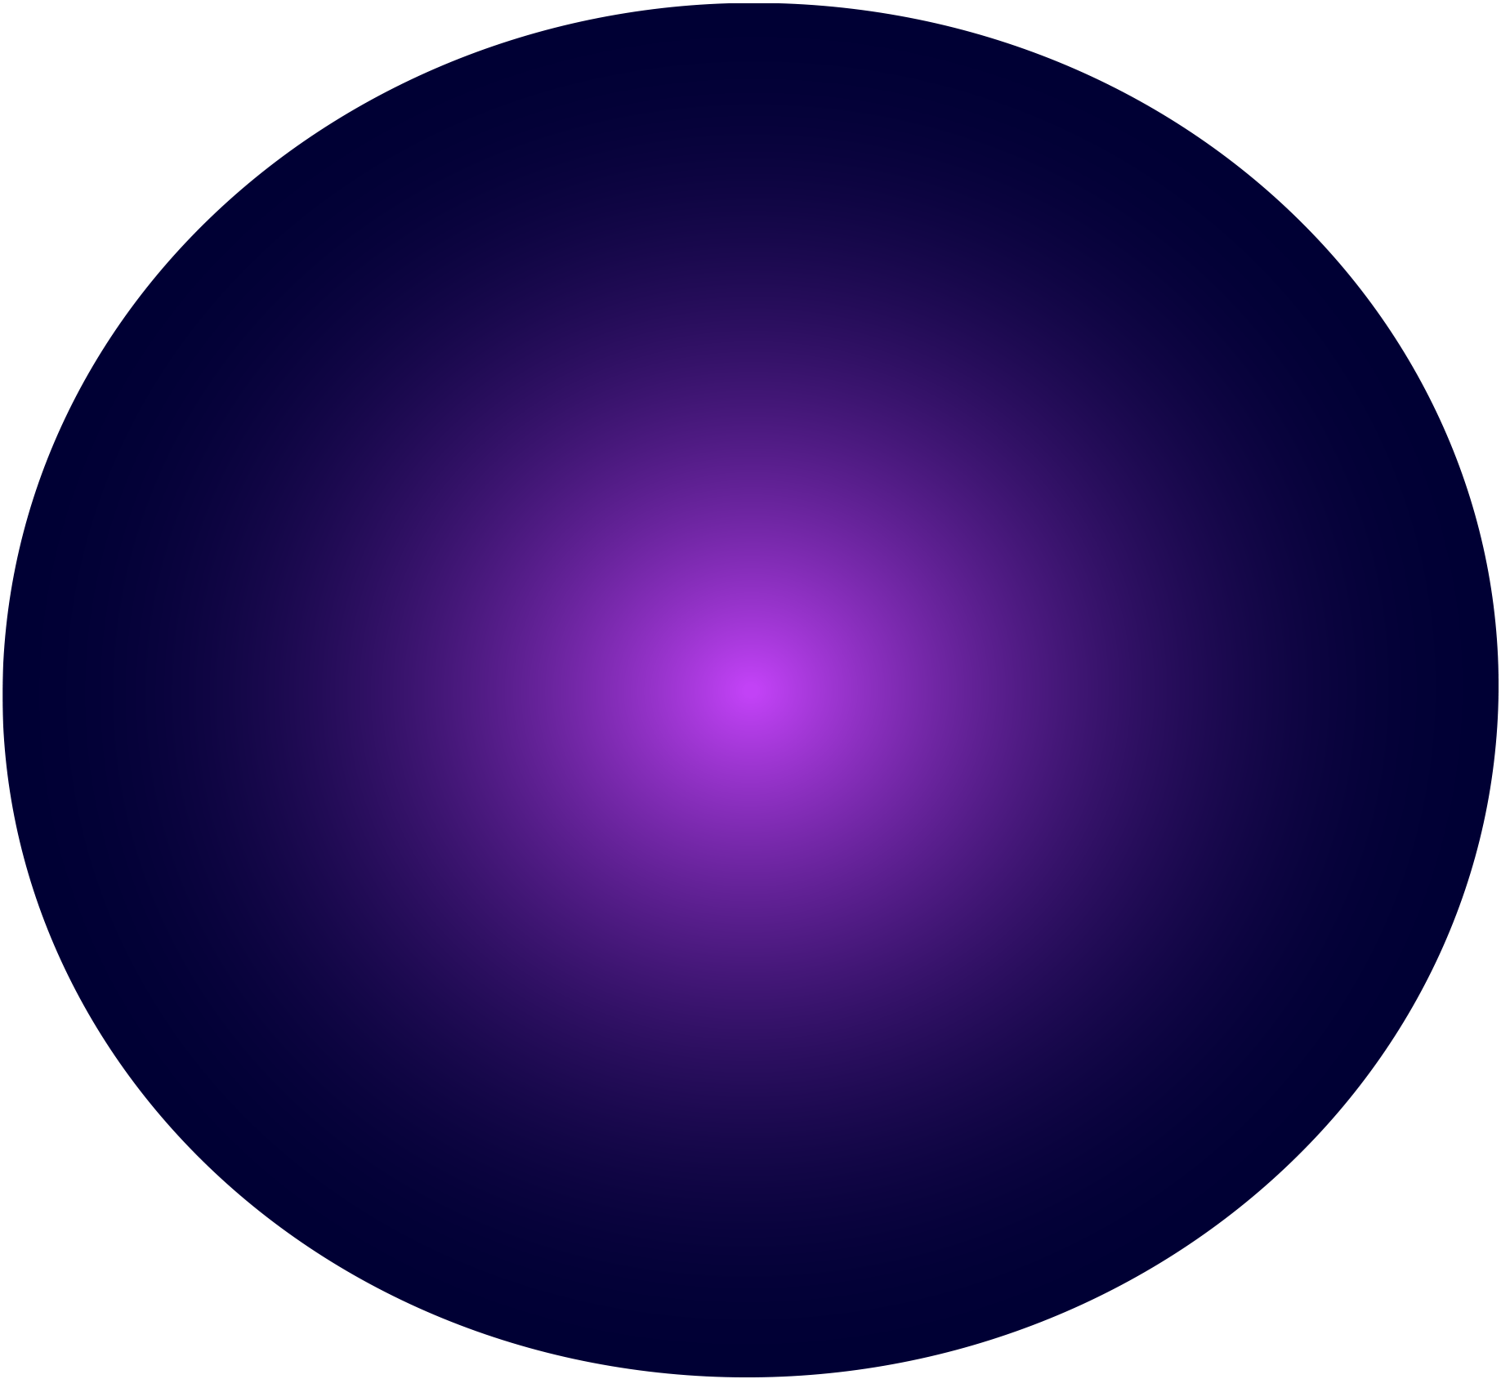


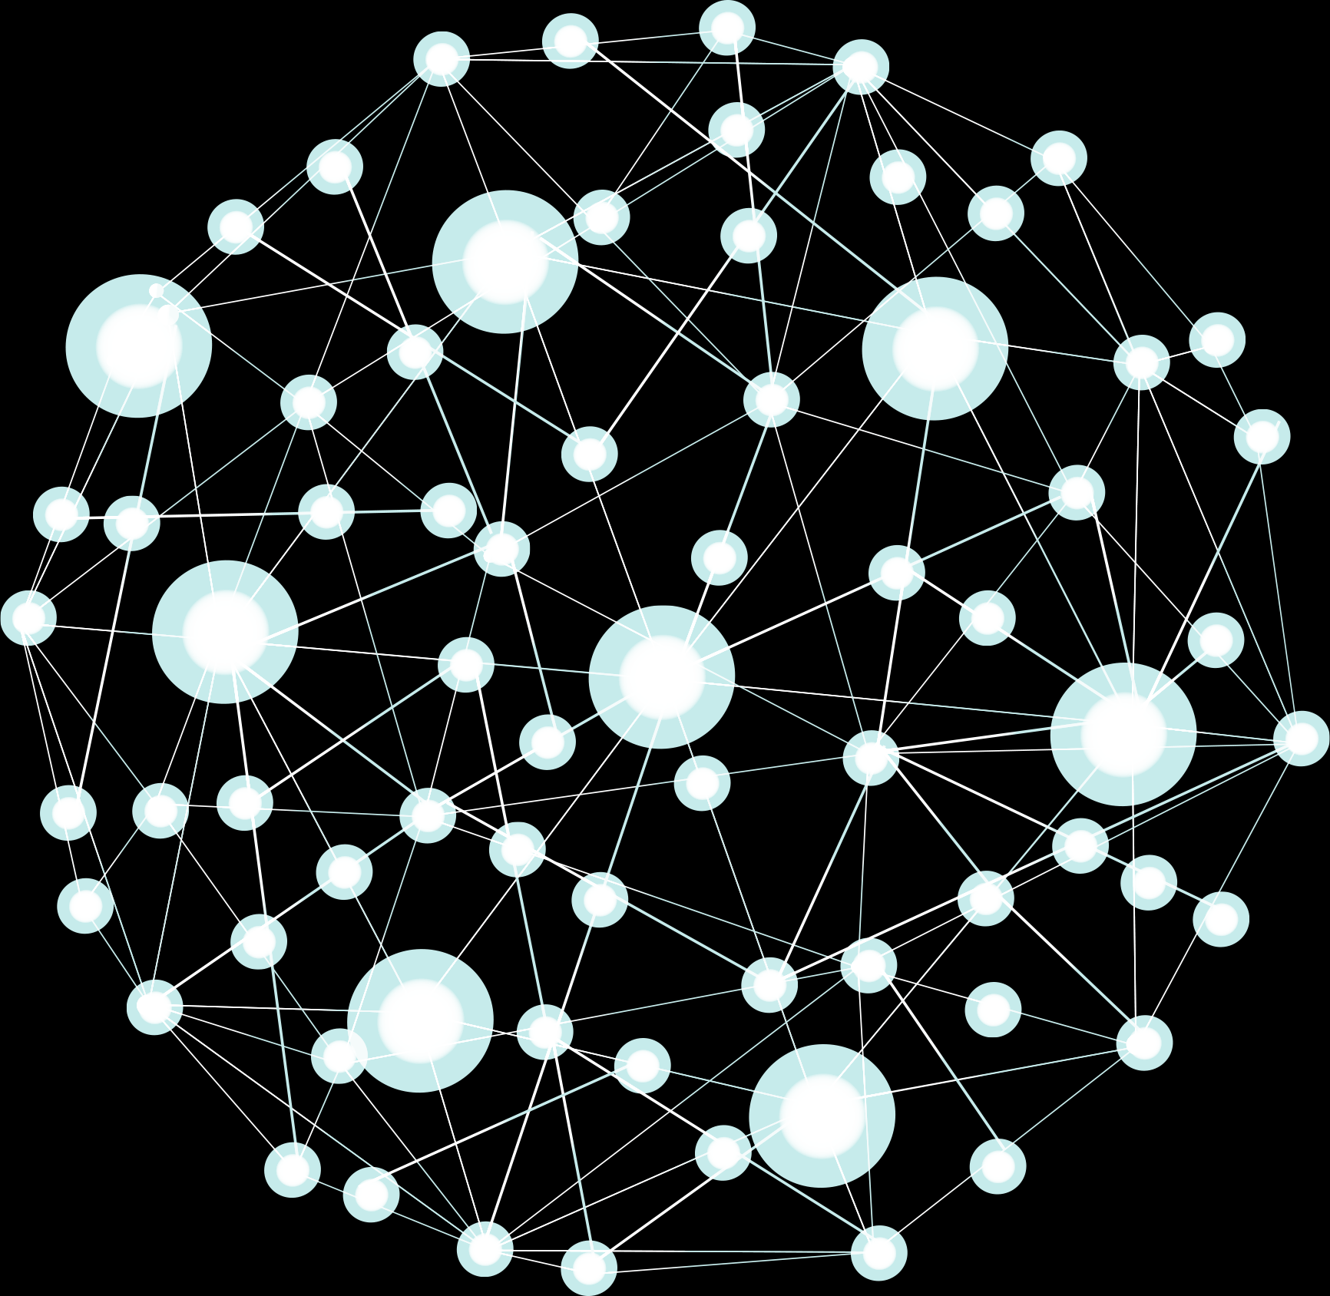
Spark Based Distributed Deep Learning Framework
For Big Data Applications
Course: Big Data
Prepared by: Li Nita, Han Chandeth, Noun Roatny

Slide 2
Table of contents
01
02
03
04
05
06
Introduction
Related Works
Spark Based Distributed Deep Learning Framework For Big Data Application (SDDLF)
Big Data Applications
Experiments and Results
Conclusion

Slide 3
01
Introduction

Slide 4


Introduction
Deep Learning architectures, such as deep neural networks, are currently the hottest emerging areas of data science, especially in Big Data.
Deep Learning could be effectively exploited to address some major issues of Big Data, including withdrawing complex patterns from huge volumes of data, fast information retrieval, data classification, semantic indexing and so on.
In this paper, the authors designed and implemented a framework to train deep neural networks using Spark, fast and general data flow engine for large scale data processing
The design is similar to Google software framework called DistBelief which can utilize computing clusters with thousands of machines to train large scale deep networks.
Training Deep Learning models requires extensive data and computation. The proposed framework can accelerate the training time by distributing the model replicas, via stochastic gradient descent, among cluster nodes for data resided on HDFS.

Slide 5
02
Related work

Slide 6

DistBelief Framework by Google
DistBelief, was developed to exploit computing clusters with thousands of machines to train large-scale algorithms.
Within the framework, two brand new techniques for large-scale distributed training were designed and implemented (1) Downpour SGD, an asynchronous stochastic gradient descent procedure which uses adaptive learning rates and supports a large number of model replicas, and (2) Sandblaster L-BFGS, a distributed implementation of L-BFGS that uses both data and model parallelism.
The main win is that both techniques are designed to tolerate variance in the execution speed of different model replicas, and even the total failure of model replicas which might be taken offline or restarted at random.

Slide 7
B. SparkNet by AMPLab
Sparknet was built on top of Spark and Caffe for scalable, distributed algorithm for training deep networks.
SparkNet also includes an interface for reading from Spark's data abstraction, known as the Resilient Distributed Dataset (RDD), a Scala interface for interacting with the Caffe Deep Learning framework (which is written in C++), and a lightweight tensor library.
developers claim that there are numerous additional benefits to realize by integrating Deep Learning into an existing data processing pipeline. Spark would allow cleaning, pre-processing, and other data related tasks to be handled via the single system, and datasets could be kept in memory for the entire processing pipeline, eliminating expensive disk writes.

Slide 8
C. Large-scale MapReduce-based Deep Learning
The main focus of this project is to integrate Deep Learning algorithm with cloud computing system to manipulate huge scale data.
In this project, implementation of Deep Learning method to train the input data, in which MapReduce programming model is exploited to parallelize the execution.
The MapReduce job consists of the mapper and reducer procedures, in which the mapper procedure will withdraw key/value pairs from input data and dispatch them into a list of intermediate key/value pairs, and reducer procedure combines these intermediate values according to the same key computed from mapper procedure to generate output values.

Slide 9
03
SPARK BASED DISTRIBUTED DEEP LEARNING FRAMEWORK
FOR BIG DATA APPLICATIONS (SDDLF)

Slide 10
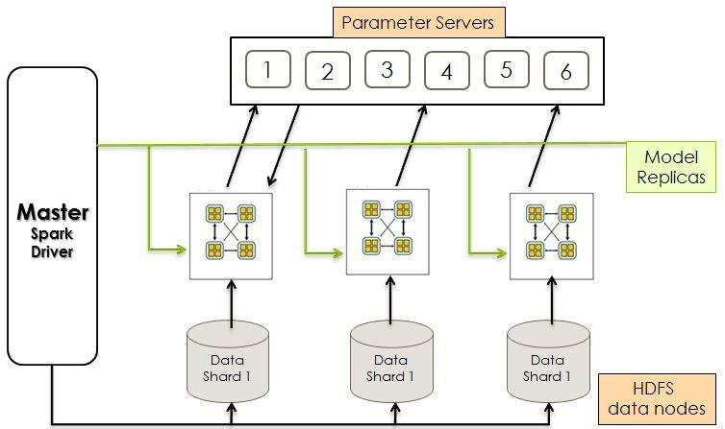
Overall Architecture
The system is designed for training deep networks using Stochastic Gradient Descent optimization algorithm with the help of distributed capabilities of Apache Spark. The system consists of Master, Parameter Server and Data Shards.
The system’s Master plays a role of Spark’s Driver Program and starts the neural network training process by the initialization of parameters in Parameter Server and neural network layers, all of them reside on HDFS. Each data shard spawns neural networks layers according to the network layer size and is responsible for computing forward and backward passes for each data example in its partition until processes all examples.
After each iteration, it will update the master model by sending newly computed gradients to master model of Parameter Server.
The method for computing gradients exploits both data and model parallelism: Data Parallelism: the training data is partitioned across several machines in the Spark cluster each having its own replica of the model. Each model trains with its data shard (partition) in parallel; Model Parallelism: the layers of each deep network model replica are also distributed across Spark cluster. The number of parameter matrix of each model depend on the number of neural network size, for example, if data shard’s model consists of 5 layers there are 4 parameter shards for this data shard.

Slide 11
B. Main Components
Master (Spark Driver)
Parameter Server
Data Shard
The Master is responsible for coordinating and scheduling the training process on the cluster.
The Parameter Server manages neural network model parameters across machines, updating them based on received gradients.
The Data Shard creates model replicas, retrieves parameter updates, and processes data points, repeating the cycle until all data points are processed.

Slide 12
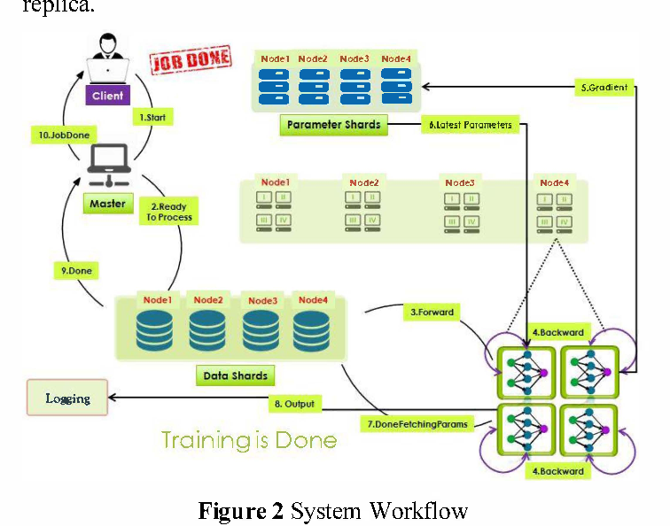
C. System Workflow
In simpler terms, imagine a team of workers (model replicas) splitting a big task (training a model) into smaller parts (data partitions). Each worker has its own set of tools (weights) kept in a central toolbox (parameter server), and they communicate asynchronously to get the job done faster. The workflow is like a boss (client) telling everyone to start, the workers getting ready, and then they dive into their tasks.
SGD (Stochastic Gradient Descent) trains the model works as:
- data partitions each train their own model replica with their partition of the data.
- each model replica is partitioned across machines by layer.
- The weights for the model are kept in a central parameter server
- Each parameter partition keeps the parameters for one layer of the model.
- Hence, as the model replicas are trained in parallel, they asynchronously read (in the forward pass) and update (in the backward pass) their corresponding weight parameters.
- This implies that the weight parameter that a model replica layer reads might have been
previously updated by the same layer from a different model replica.

Slide 13
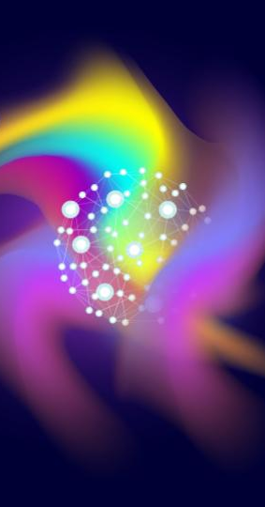
04
BIG DATA APPLICATIONS

Slide 14
A. Information Retrieval and Semantic Indexing
B. Discriminative Works
C. Sentiment Analysis
One of the prominent areas of Big Data Analytics is information retrieval. Traditional approaches struggle with the scale and diversity of Big Data (text, image, video, audio). The solution proposed is semantic indexing which can defines the data in a more sufficient fashion
and becomes useful as a source for information discovery and
understanding, for instance by impacting search engines
operate faster.
Conducting discriminative works in Big Data Analytics one could exploit Deep Learning models to obtain complex nonlinear features from the raw data, and then apply simple linear methods to execute discriminative works exploiting the
acquired features as input.
The key benefit is to enable
and make a proper environment for practitioners and analysts
to fulfill complex operations related to AI, such as image
comprehension, object recognition in images and so on, by
exploiting trivial models.
With the rise of social media such as blogs and social
networks, reviews, ratings and recommendations, a surge
of research in sentiment classification (or sentiment analysis) was created aiming to determine the judgment of a writer with respect to a given topic based on a given textual comment.

Slide 15
05
EXPERIMENTS AND RESULTS

Slide 16
In this section, we present experiments and their results of twitter sentiment analysis application which was designed on top of our system.
corpus of public tweets, one-year-data, more than 160 mln tweets and on a daily basis, around 1.2 mln tweets.
Use Streaming API to retrieve data.
Training and test datasets (70/30)
Perform preprocessing before actual training
Tokenize on training data
Vectoring was conducted using
word2vec
Output from word2vec was fed into
nonlinear deep learning model
Measure Error Rate

Slide 17
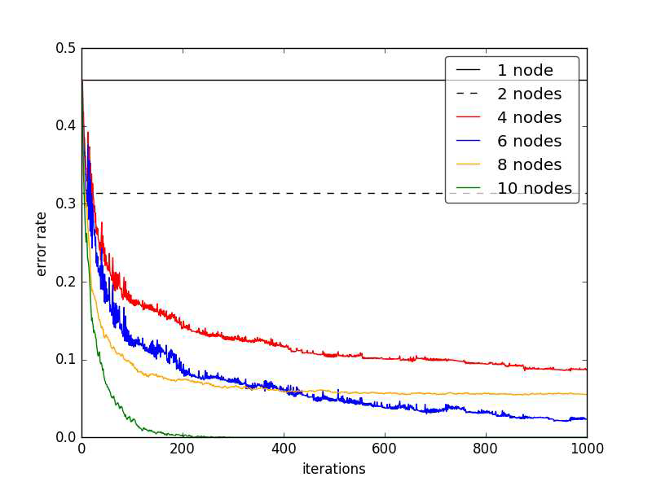
The error rate of the model classifier showed a steady decrease in each iteration, and tries to reach the convergence point, the threshold where the error rate is acceptable and good enough to be used for new unseen data.
From the Figure , it can be seen that as the number of nodes increases, the convergence time reduces respectively especially, in 10 nodes, the green line in the given chart, the model reached the acceptable threshold after 200 iterations.

Slide 18
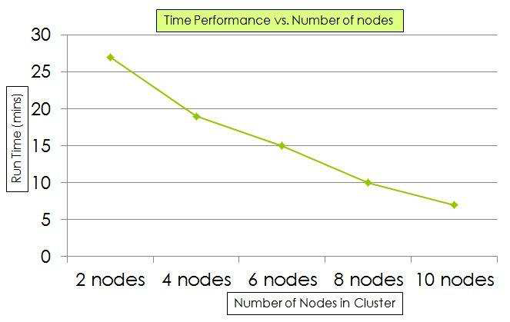
We also achieved a good performance in terms of run time as depicted.
From the graph one the right, it can be seen that as the number of nodes increase the overall performance will also increase. The runtime behaviour of the system also depends on the other
factors such as JVM overhead, system processes, network latency, and so on. But we did not show their stats as it is
negligible.
Overall, we gained satisfactory results from the proposed system, however, there are a lot of room for further improvement and new features.

Slide 19
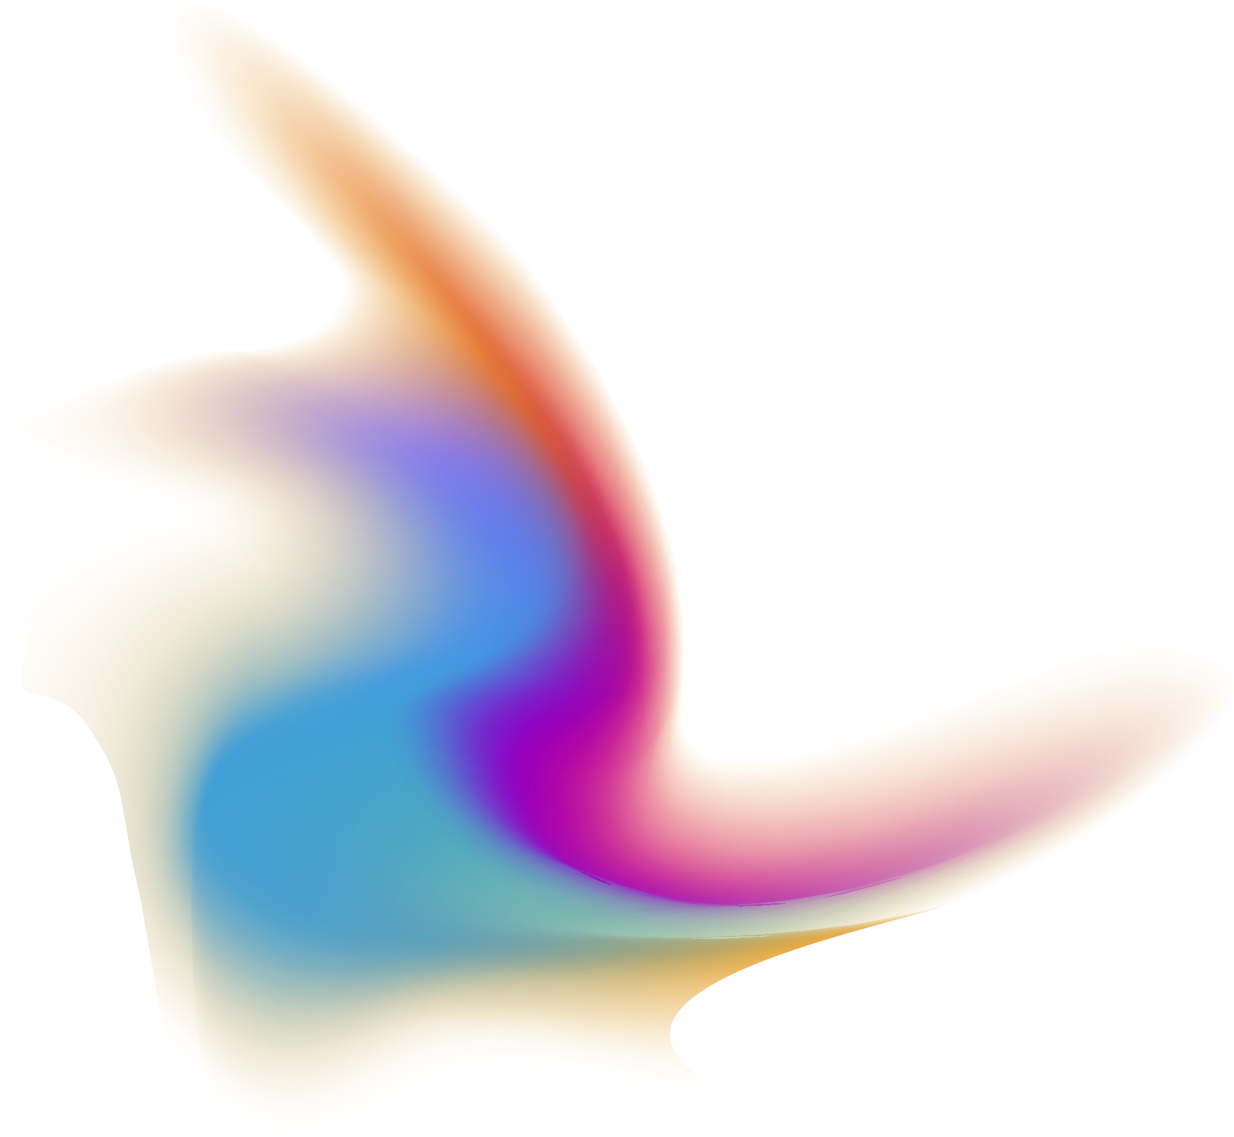
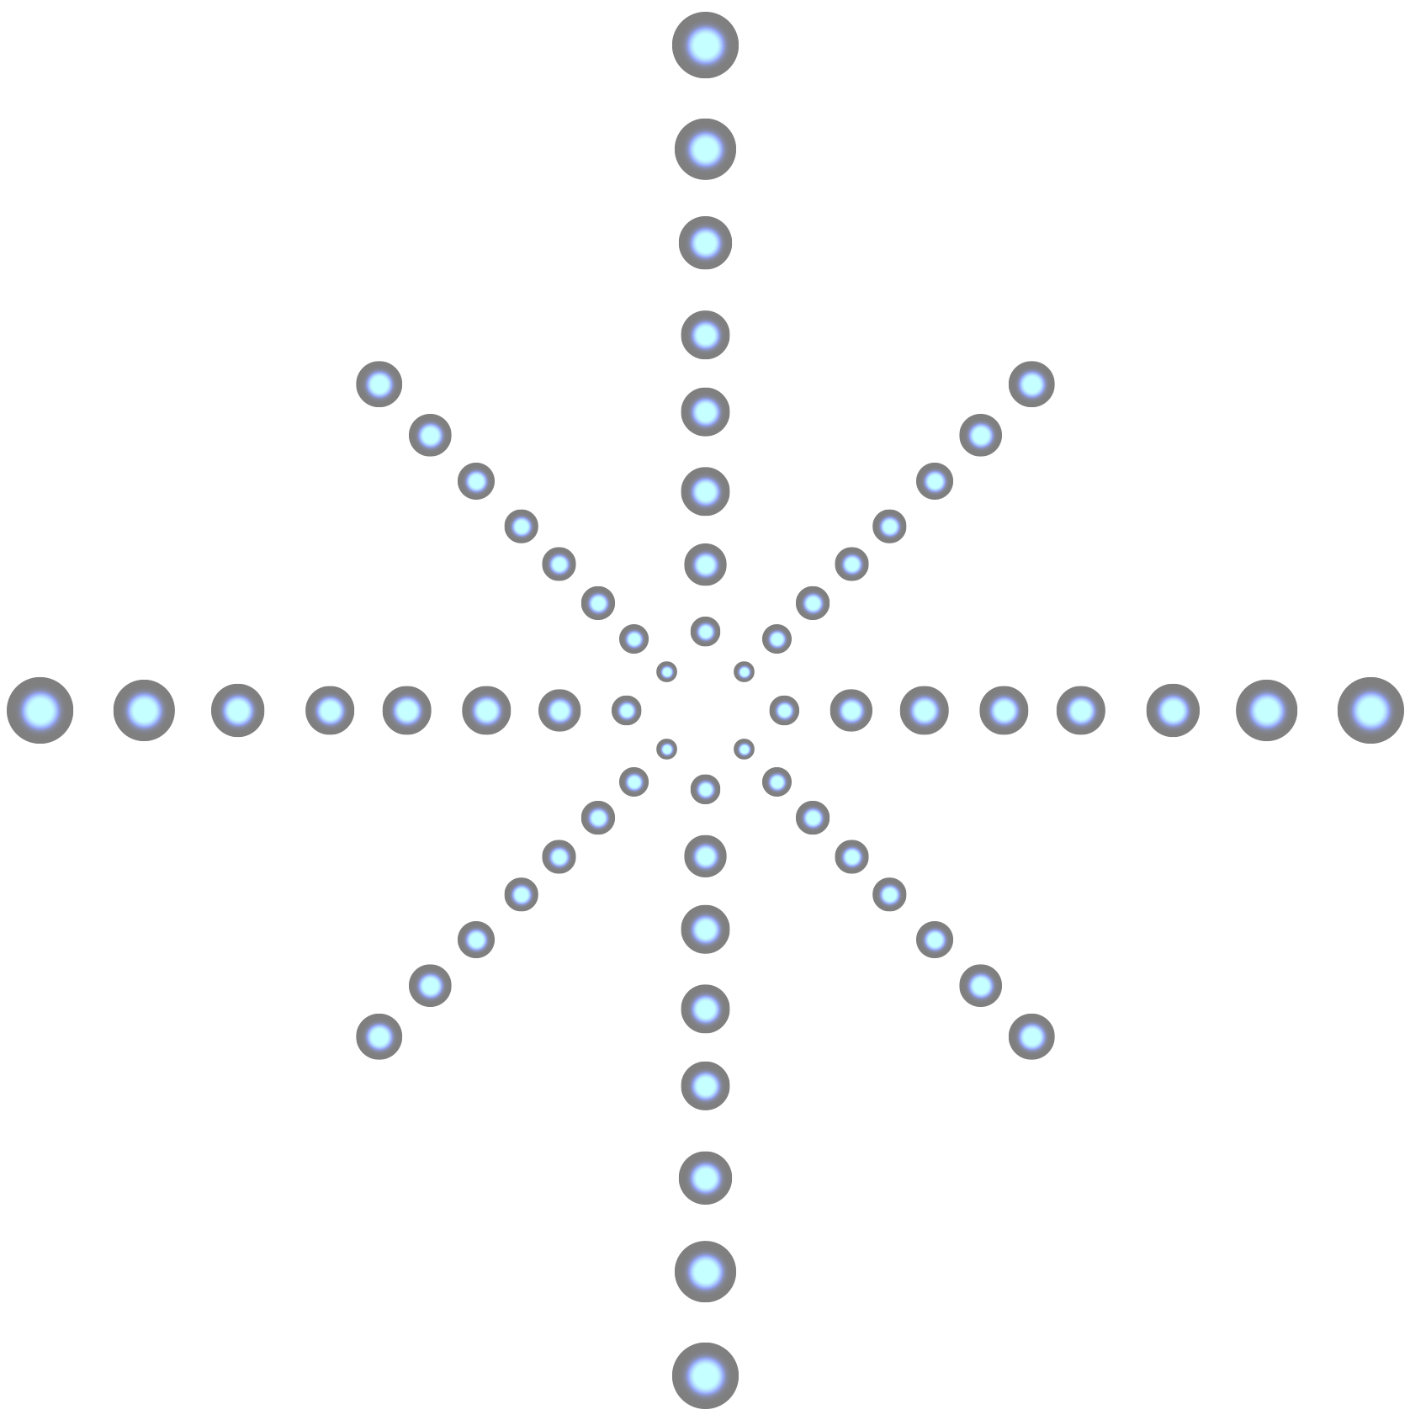
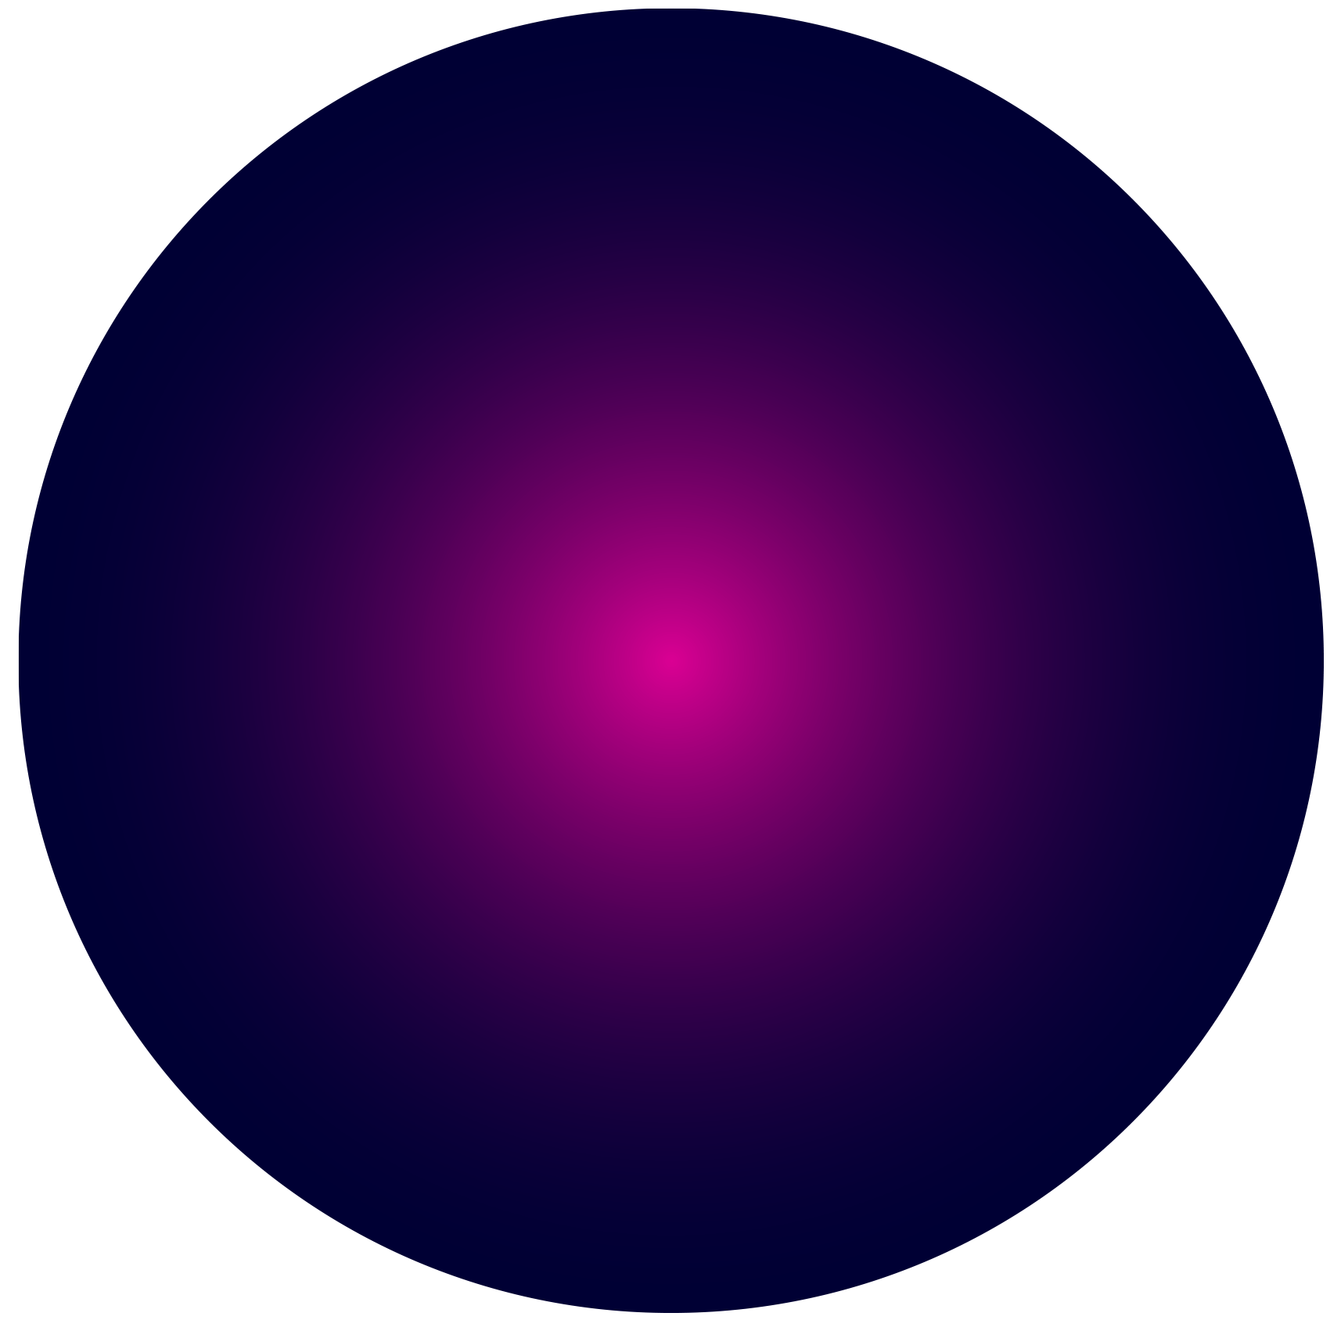


Conclusion
The primary objective of this project was to create a Distributed Deep Learning Framework designed for Big Data applications. We successfully deployed the suggested system using Apache Spark with satisfactory performance in terms of both time and accuracy.and deep network training in our system relies on the widely used distributed Stochastic Gradient Descent method, known as Downpour SGD.
As a future work, we plan to add more Deep Learning algorithms on the system stack and tweak the overall system so that it can be utilized in real world Big Data applications.

Slide 20
Thank You!
Any Questions?

